Slide 1
Creating a Serverless Cloud Native app on Azure

Slide 2
Overview

Slide 3
Overview
Technical overview 20min
2 main parts (worksheets)
Create backend then frontend
We will work each step together
Clone repo and both solutions are there
Light overview, should go deeper

Slide 4
Architecture

Slide 5
RFC
React, Functions and Cosmos
Most cost-effective highest scale

Slide 6
Why React
Very modern platform
Easy to use
Rapid development
Massive plugin options
Fluent UI

Slide 7
Why Functions
Serverless
Massive scale
Great price
Fits microservices pattern very well
Security options CORS, AAD

Slide 8
Why Cosmos
NoSQL rapid development
High data integrity
Object depth
Indexing nodes

Slide 9
Part 00
Setup Backend

Slide 10
Overview
Create middle tier
Create database

Slide 11
Function App Setup

Slide 12
Lessons learned
Binding vs Static
CORS
Execution policy
Notes:
This demo uses Static functions like a normal programming API. Play close attention to making your objects static or you will run over connection limits
This demo uses CORS to protect access. AAD can be integrated.
On a new development box you might get excitation policy issues. I have included PowerShell instructions.

Slide 13
Build data store

Slide 14
Lessons learned
Straight forward
API types
Notes:
Could take a bit to provision
Several API types, sql core is like normal sql

Slide 15
Create project

Slide 16
A quick word on micro services
Noun based
Notes:
This project uses a microservice pattern where the endpoint is a noun with verbs to handle functionality.

Slide 17
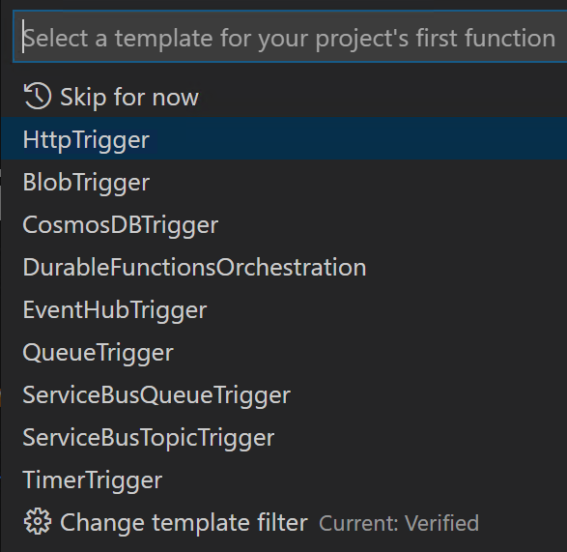
Lessons learned
Several language options
Function types

Slide 18
Create storage container

Slide 19
Lessons learned
Cosmos vs Storage
RU
Partition key
Notes:
Cosmos costs more than raw azure storage but gives you the ability to query. If you have a strong partition strategy, then storage might be better. Data explore you can query like sql. Many also wire azure search against the table storage.
RU is how much it takes to process. Be careful on query's this is where the costs are.
Partition key is important to get right. It is much cheaper to design this in the beginning.

Slide 20
Setup Cosmos

Slide 21
Lessons learned
Reopen VS Code
In console enter “code .”
Binding vs Static
DAL
Notes:
This demo uses Static functions like a normal programming API. Pay close attention to making your objects static or you will run over connection limits.
This demo uses a DAL static class to handle the static connections.
Receive Connection string from portal: Settings\Keys\Primary Connection String
Reference complete project if the folder structure is confusing
Code . Shortcut
If invalid character remove spaces

Slide 22
Test Project

Slide 23
Lessons learned
In this step we place test code to add a Bike to the database
Then open cosmos and review the added JSON
This code will be removed later

Slide 24
Complete Bike service

Slide 25
Lessons learned
These steps add the basic CRUD operations
The last step adds the conditional microservice verb actions
Notes:
In the last step we determine the intent of the action by what verb is submitted to the service. GET is usually a read, PUT is an update, POST is a create and at time we can use DELETE.

Slide 26
Create Bikes service

Slide 27
Lessons learned
Single implementation of a get all

Slide 28
Test service

Slide 29
Lessons learned
Start with a Bikes get
When we can update and add as a test

Slide 30
Deploy Service (Optional)

Slide 31
Lessons learned
Deployment is straight forward
Many deployment models now
After deployment receive code
Notes:
The code is an azure active directory token appended to the query string with a ?Code=token. More advanced security would be to obtain a token from AAD dynamically.

Slide 32
Enable Frontend

Slide 33
Lessons learned
CORS
Azure API Management
AAD
Notes:
In this walkthrough we are using CORS to secure our API. Is this is setup correctly it will block traffic from all servers other than what you list. You can increase security my implementing Azure API management and Azure Active Directory.

Slide 34
Setup Frontend
Notes:
React Overview:
Render method is the body return
You have to override all events
There is “state”

Slide 35
Overview
Create frontend, 3 subs
Show Bikes
Add Edit quantity
Add Bike
Notes:
Note: Builds on each level
Each one adds to the interface
Each one adds to the constructor
Each one adds UI

Slide 36
Lessons learned
Fluent UI
Notes:
Tip: right click format document
Tip: hover quick fix

Slide 37
Bikes Component

Slide 38
Lessons learned
These are individual files
In this step will render the basic app
Add more over the next few steps

Slide 39
Classes

Slide 40
Lessons learned
Camel cased binding to JSON

Slide 41
Show data

Slide 42
Lessons learned
Big step
Add a new interface for the member variables
Add styles for Fluent
Change component definitions to inject interface
componentDidMount()
URL from Azure Functions
Render calling RenderBike per item in collection
Notes:
Review different react lifecycle steps
Challenging step, review completed solution for clarity if needed

Slide 43
Add edit quantity

Slide 44
Lessons learned
Add items to the interface
Add a bit more styling
In this, you have a Fluent panel that opens where you can change the quantity.
Notes:
Complicated step, refer to solution for reference

Slide 45
Add “Add”
Notes:
Note: make sure line spaces are correct. Syntax errors!

Slide 46
Lessons learned
Last step, almost same as edit

